Slide 1
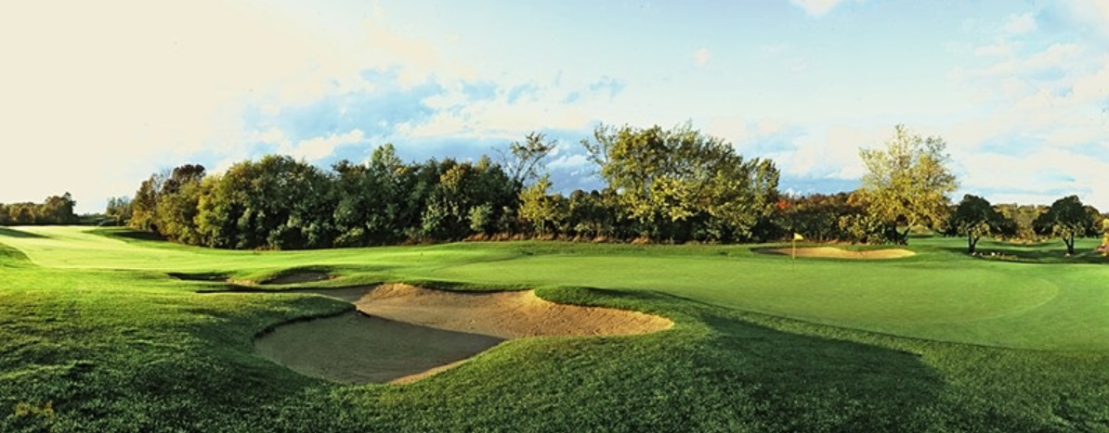
For Sale The BOG Saukville, Wisconsin
Offering Price: $3,500,000

Slide 2
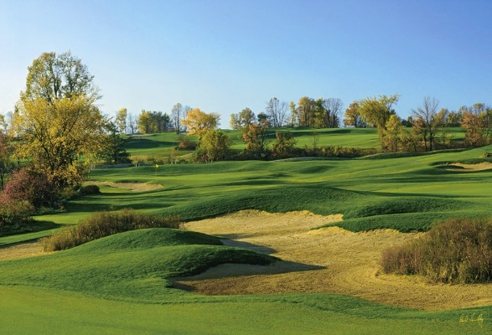
The BOG

Slide 3
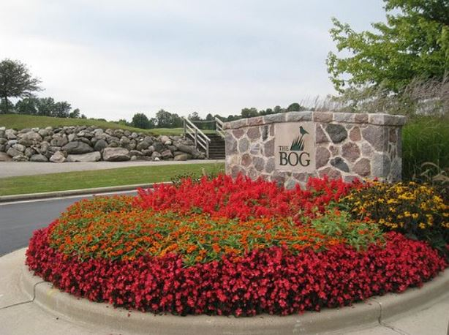
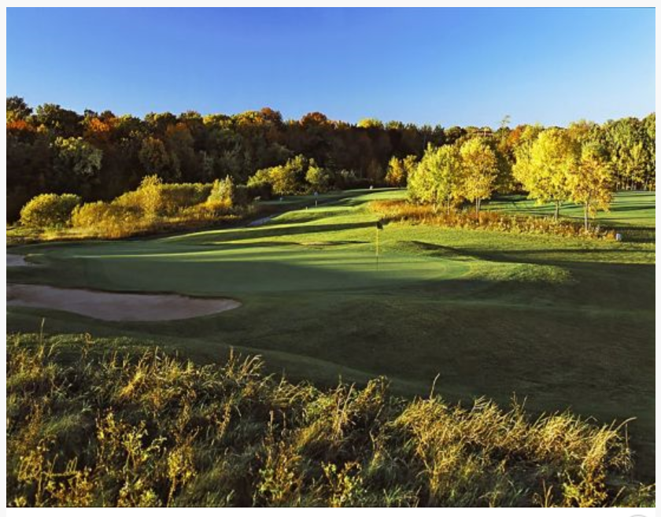
The Offering
The BOG is regarded as the pre-eminent daily fee golf course in the Milwaukee metro region, with the best practice range in the area and a right-sized clubhouse of 10,000 square feet. Designed by the legendary Arnold Palmer, the course rolls through a stunning environment of woods, wetlands, rolling hills and wildlife habitat – like no other course in the area. The BOG is poised for a rebirth with a new owner focusing on taking the facility to the next level.

Slide 4
Acquisition Opportunity
The best daily fee course in the Milwaukee market
Opportunity to buy existing golf course at a fraction of replacement cost
Gross Revenues average nearly $1,700,000 over most recent five-year period
The 10,000-square-foot clubhouse is ideal for banquets, weddings and outings of almost any size
Pure golf experience cannot be matched anywhere in the area
A commitment to improving the quality of the overall golf and dining experience will allow the new owner to increase membership, outings and total revenues
The best practice facility in the Milwaukee market makes The BOG a must-play for serious golfers
Email list of over 18,000 golfers will be transferred with the sale
Additional 10.38-acre parcel at the southeast corner of State Hwy 33 and County Hwy I included in the sale; ideal for golf course signage and/or future development

Slide 5
Property Overview
The BOG is an Arnold Palmer Signature Design golf course founded in 1995. The facility includes a public 18-Hole, par 72, championship layout which is playable from 5,110 – 7,221 yards
The course layout is constructed on nature’s Cedarburg Bog flowing through terrain of 226 acres of woods, wetlands, rolling hills and wildlife habitat. The BOG features 118 bunkers throughout the course and bentgrass greens built to USGA specifications, which will rival any putting surfaces in Wisconsin. The BOG is conveniently located just off of Interstate 43, only 25 minutes north of Milwaukee and 35 minutes south of destination golf in Kohler, Wisconsin (Whistling Straits/American Club Resorts).

Slide 6
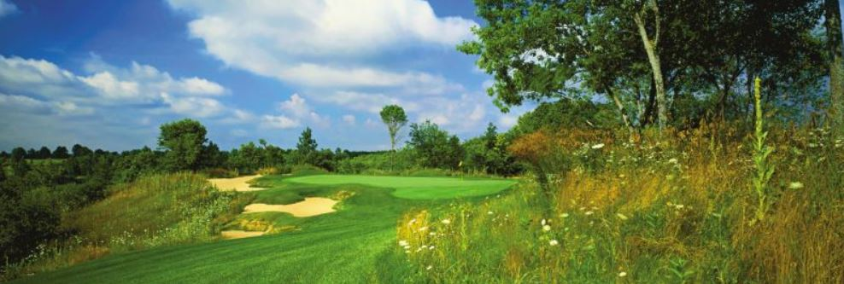
Property Overview
The BOG’s expansive Practice Center is 15 acres, and is complete with bentgrass tees, target greens, chipping areas, greenside bunker areas, a putting green and private lesson areas. The Practice Center has been awarded TOP 50 Public Ranges in America by Golf Ranges Association of America (GRAA) in 2012 & 2014.
The BOG’s 10,500-square-foot Clubhouse features full amenities: bar, restaurant, on-course food & beverage, and wedding, banquet & conference services. The Banquet Facility is perfectly designed for Golf Outings, Weddings and a myriad of social banquet events with seating for up to 160 guests in the dining room and additional seating on the patio overlooking hole #18.

Slide 7
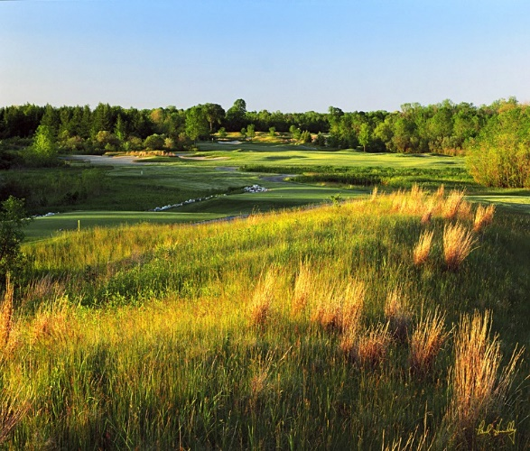
Property Overview
Location: 3121 County Highway I, Saukville, WI
Acreage: 226.6 acres
Holes: 18 holes
Yardage: 7,221 yards
Slope: 143
Opened: 1995
Clubhouse Square Footage: 10,500 square feet
Amenities: Pro Shop, Bar/Grill, Banquet Room for 160 guests
Maintenance Equipment: A full list of equipment is available upon request
Irrigation source: Seven on site wells
Website: www.golfthebog.com

Slide 8
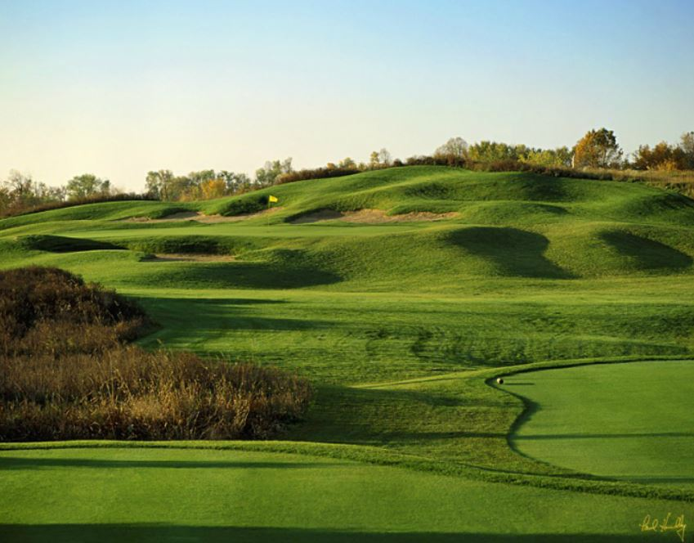
Property Overview
Irrigation System: Toro with 990 full circuit rotors,
223 part time rotors and 441 pop up Spray Heads
Golf Carts: 80 Leased EZ Go Electric Golf Carts
Maintenance Facility: 9,830 square foot metal-
framed structure.
Grass Types: Creeping Bent Grass
Cart Paths: Continuous throughout the course
Practice Facility: 300-yard practice facility with
40,000 square feet of bent grass teeing surface
and 6 target greens.
Zoning: P-1 Park and recreation
Golf Course Architect: Arnold Palmer

Slide 9
Financial Analysis
Actual Performance – 2010 through 2014
*Greens Fees and Golf Operations revenue is grouped into one category for 2014
**Add-Back Expense consists of the portion of owner’s assistant’s salary that was not related to The BOG and would not be an ongoing expense for a new owner (amount for 2010 is estimated)

Slide 10
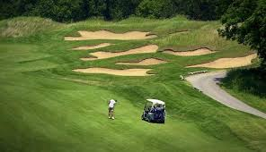
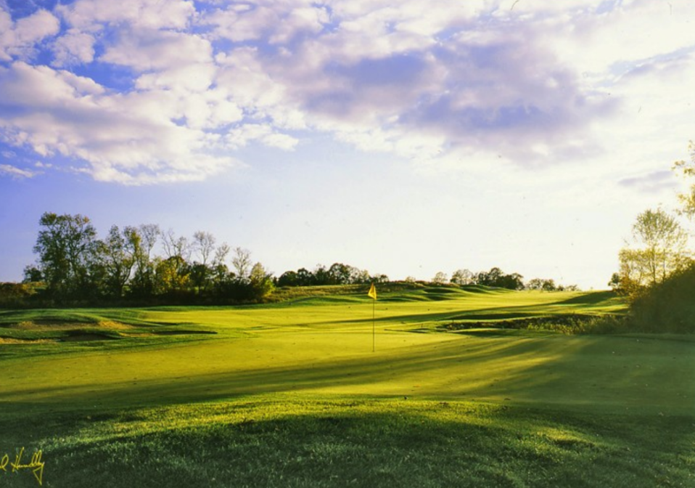
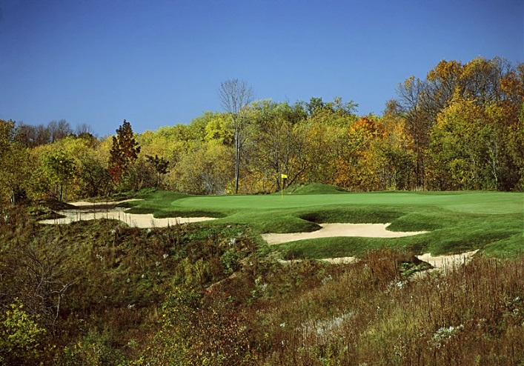
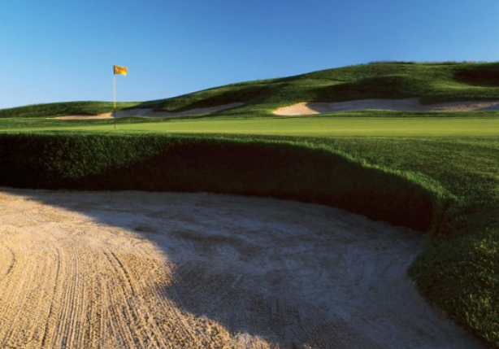
Property Photographs

Slide 11
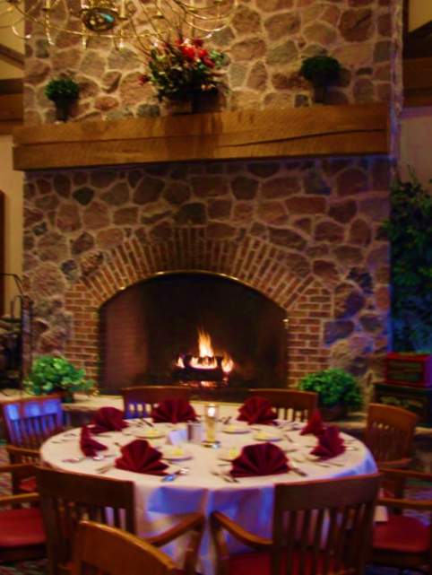
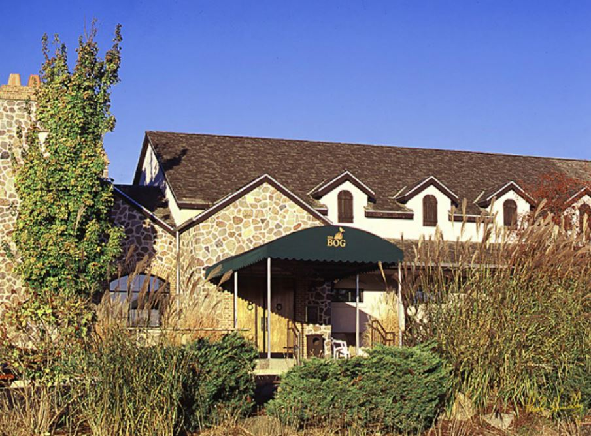
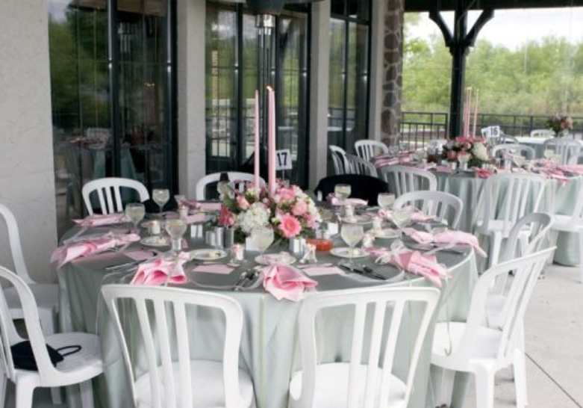
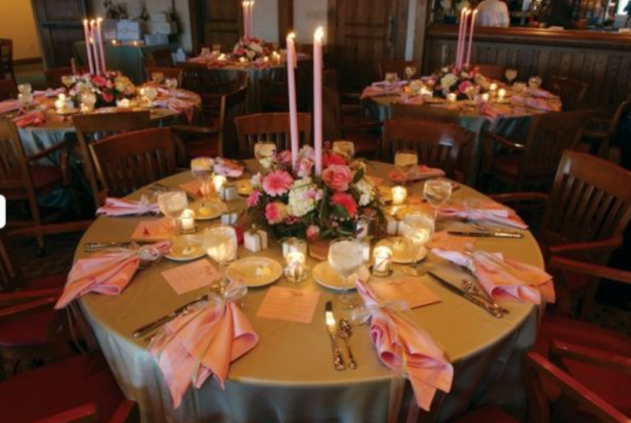
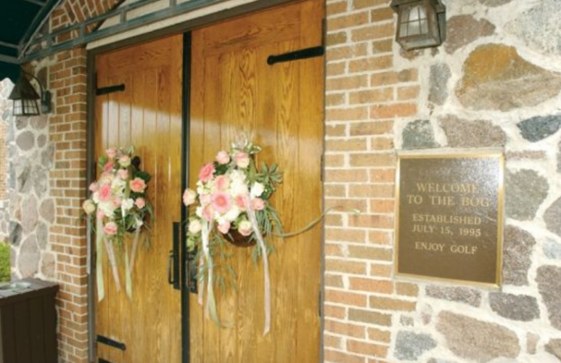
Property Photographs

Slide 12
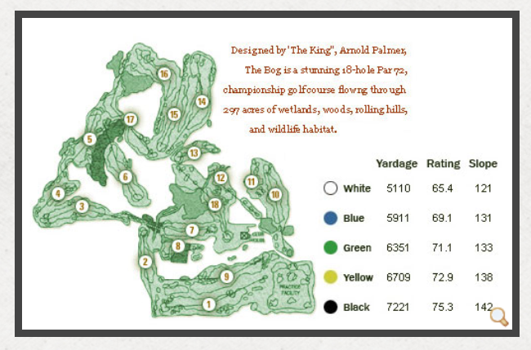
Course Layout

Slide 13
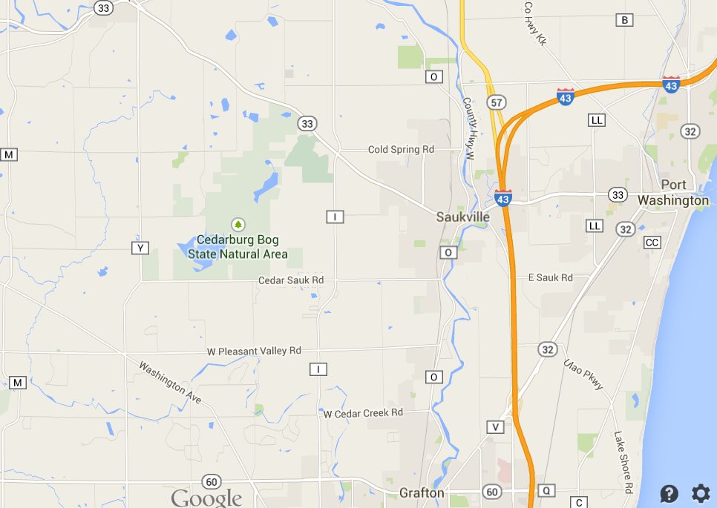
Area Map

Slide 14
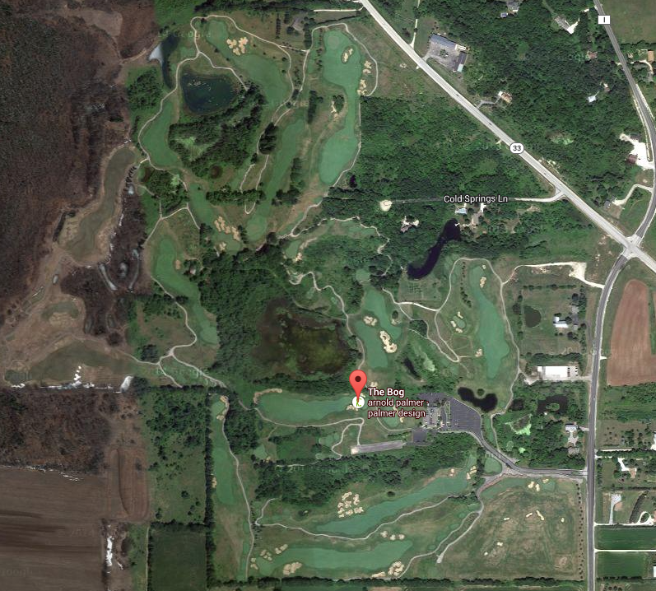
Property Aerial

Slide 15
Course Awards and Tournament History
2014: TOP 5 Arnold Palmer Courses You Can Play in US by Golf Channel 2014: WPGA Assistant's Event 2014: WPGA Junior Player's Tour Event 2014: WSGA Senior Player's Tour Event 2013- WSGA State Amateur Championship 2013- WSGA Board Meeting & Golf Event 2012 & 2014- Ranked in the Top 50- Public Golf Ranges in America by GRAA 2004-14: Ranked in the TOP 10 Best Overall Golf Courses in all of Wisconsin by Golf Digest 2004-14: Rated 4.5 Stars by Golf Digest's "Places to Play" 2004-12: Highest Rated Milwaukee Area Course by The Business Journal 2012: WPGA Junior Player's Tour Event 2012: WPGA vs. IPGA Assistant's Royal Cup Championship 2011: WPGA Junior Player's Tour Event 2011: Evans Scholarship Fund Golf Outing 2011: David Leadbetter Golf Academy (DLGA)/IMGA Golf Clinic and Golf Outing 2011: Wisconson vs. Illinois Cup Matches
2010: WPGA/WSGA Premier Open Series
2009: WSGA Junior Boys State Championship 2009: Wisconsin PGA Salesperson Pro-Am 2008: WSGA/PGA Nelthorpe Cup Match Championship 2008: WPGA Junior Player's Tour Event 2006: USGA U.S. Junior Boy’s Amateur Qualifying 2006: Wisconsin PGA State Open 2005: Wisconsin PGA State Women’s Open 2005: USGA U.S. Senior Amateur Qualifying 2004: Wisconsin PGA State Senior Open 2004: WSGA State Amateur Championship 2003: Greater Milwaukee Open Pro-Am 2003: USGA U.S. Amateur Qualifying 2002: USGA U.S. Senior Open Qualifying 2002: Top 25 Midwest Golf Courses by Great Lakes Golfer Magazine 2001: USGA U.S. Mid-Amateur Qualifying 2001: WSGA State Best Ball Championship 2000: USGA U.S. Open Local Qualifying 1999: Great Lakes Amateur Championship 1998: WSGA State Senior Best Ball 1997: WSGA State Match Play Championship 1997: America's Best New Golf Courses by Golfer Magazine 1996: America's Top 10 Best New Golf Courses by Golf Digest

Slide 16
For additional information, please contact:
Chris Charnas
Links Capital Advisors, Inc.
Office 847-866-7192
Cell 312-543-7192
chris@linkscapitaladvisors.com
www.linkscapitaladvisors.com
Patrick D. Gallagher, CCIM
Siegel-Gallagher, Inc.
Office 414-270-4108
Cell 414-617-8076
pgallagher@sg-re.com
www.sg-re.com

